Slide 1

University institute of technology, Rgpv, Bhopal
( MINOR PROJECT REPORT) ON SUBMITTED BY “SHUBHANJALI GUPTA(010CA211057) SARIKA SARATHE (010CA211052) AISHWARYA SHAKYA (010CA21105)” MCA 3rd SEMESTER (Session:2022-23) SUBMITTED TO Department of Computer Applications University Institute of Technology,RGPV,Bhopal(MP)

Slide 2
Content
Introduction
Objectives
Tool and technologies
Project Overview
Future scope

Slide 3
Introduction
URL shortening is a very common and widely used process nowdays. With the presence of social media networks where the text is required to fit in a restricted number of characters usually to 140 characters, therefore shorteninig of URLs became more and more crucial. So,to shorten the long URLs, a greater number of URL shortening service used. When somebody needs to shorten their unsightly long URL they go to a URL shortening service and submit the long URL intended to get shortened. These shortened URLs are not typically longer than 30 to 40 characters. These shortened URLs are then used instead of the long URLs to visit the respective websites.

Slide 4
Objective
The application will allow users to enter a URL and an optional custom short id and generate a shorter version.
Here’s what we’re going to build:
The frontend of the application is not attractive, because the main focus of the project is building a backend project.
Some sample shortened URLs are
https://shorty-
fully functional API-driven web app that creates shortened URLs that forward to target URLs.

Slide 5
Tool and technologies
Create a REST API with FastAPI
Run a development web server with Uvicorn
Model an SQLite database
API documentation
interact with the database

Slide 6
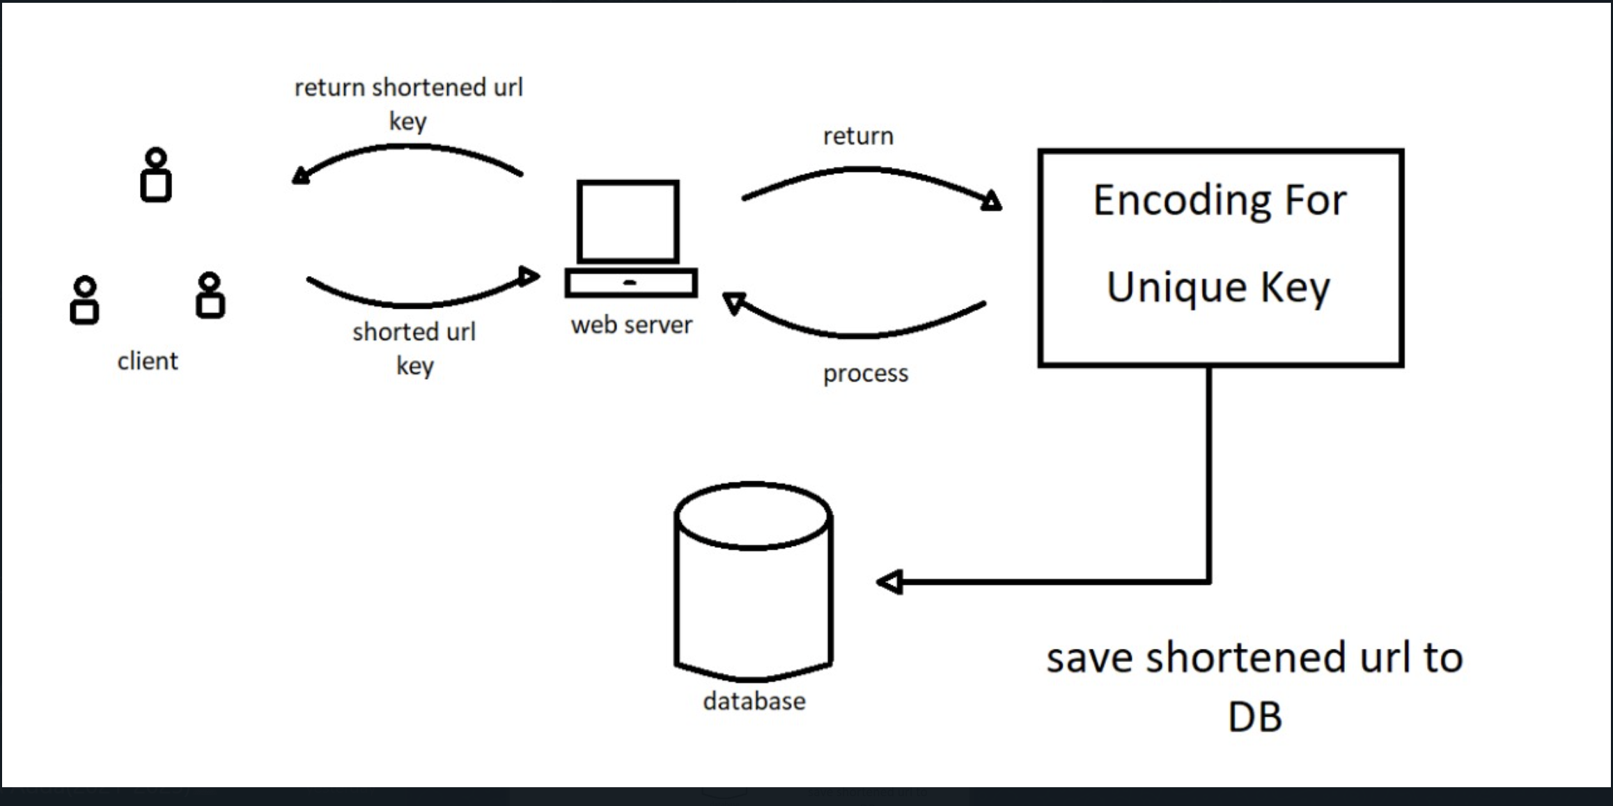
FLOW CHART

Slide 7
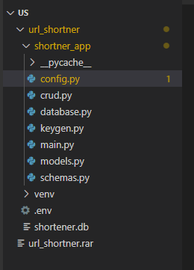
Project overview
(venv) $ python -m pip install fastapi==0.75.0 uvicorn==0.17.6
We use the FastAPI web framework to build the API,we need a web server. That’s what uvicorn is for. Uvicorn is a web server implementation for python that provides an Asynchronous Server Gateway Interface(ASGI). Web Server Gatway interfaces(WSGI) specify how your web server communication with your web application.

Slide 8
(venv)$ python-m pip install python-dotenv==1.4.32
SQLAlchemy is a Python SQL tool kit that helps you communicate with your database. Instead of writing raw SQL statements.

Slide 9
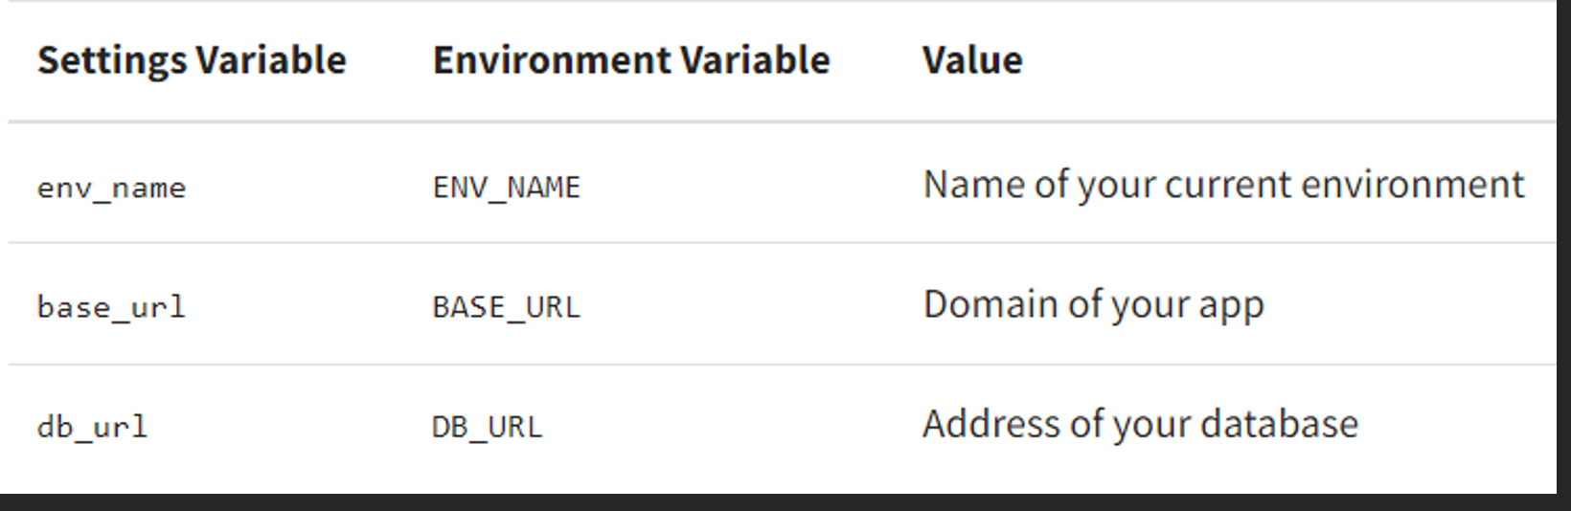
(venv) $ python –m pip install python-dotenv==0.19.2
The python-dotenv package helps you read key-value pairs from an external file and set them as environment variables.

Slide 10
(venv) $ python -m pip install validators==0.18.2
As the name suggests,the validators library helps you validate values like email addresses, IP addresses.
We will use validators to validate the URL that a user wants to shorten in your project.

Slide 11
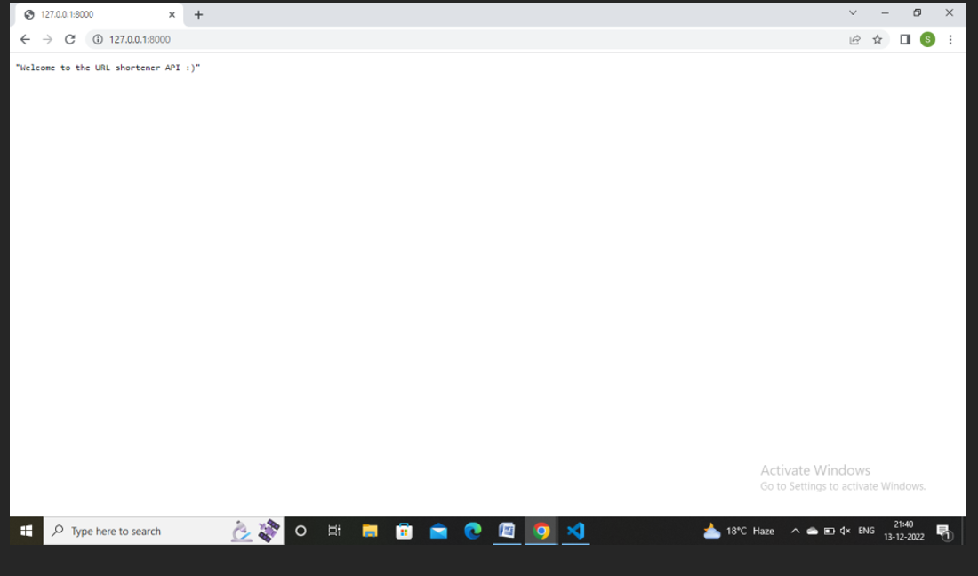
Working of url shortner
When you navigate to http://127.0.0.1:8000 in our browser, you’re sending a GET request to the root of your FastAPI. The response is the welcome message.

Slide 12
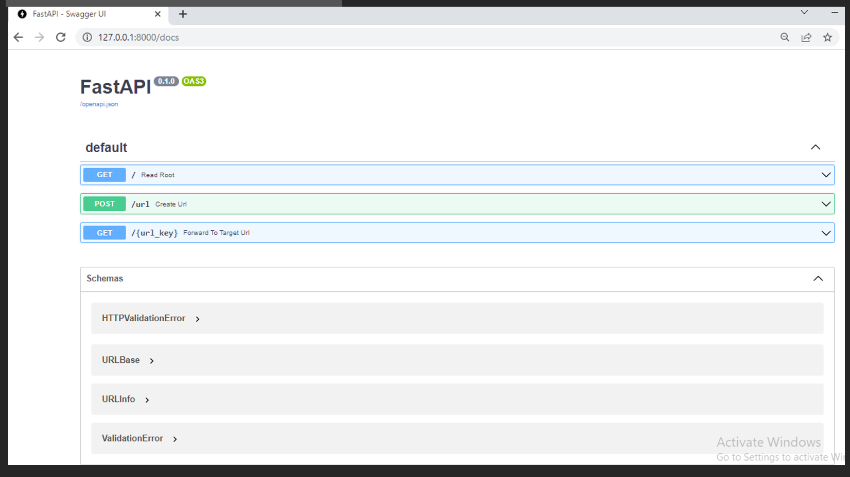
One great thing about fastapi is that the framework automatically creates documentation of your api endpoints for us.
our browser at http://127.0.0.1:8000/docs:

Slide 13
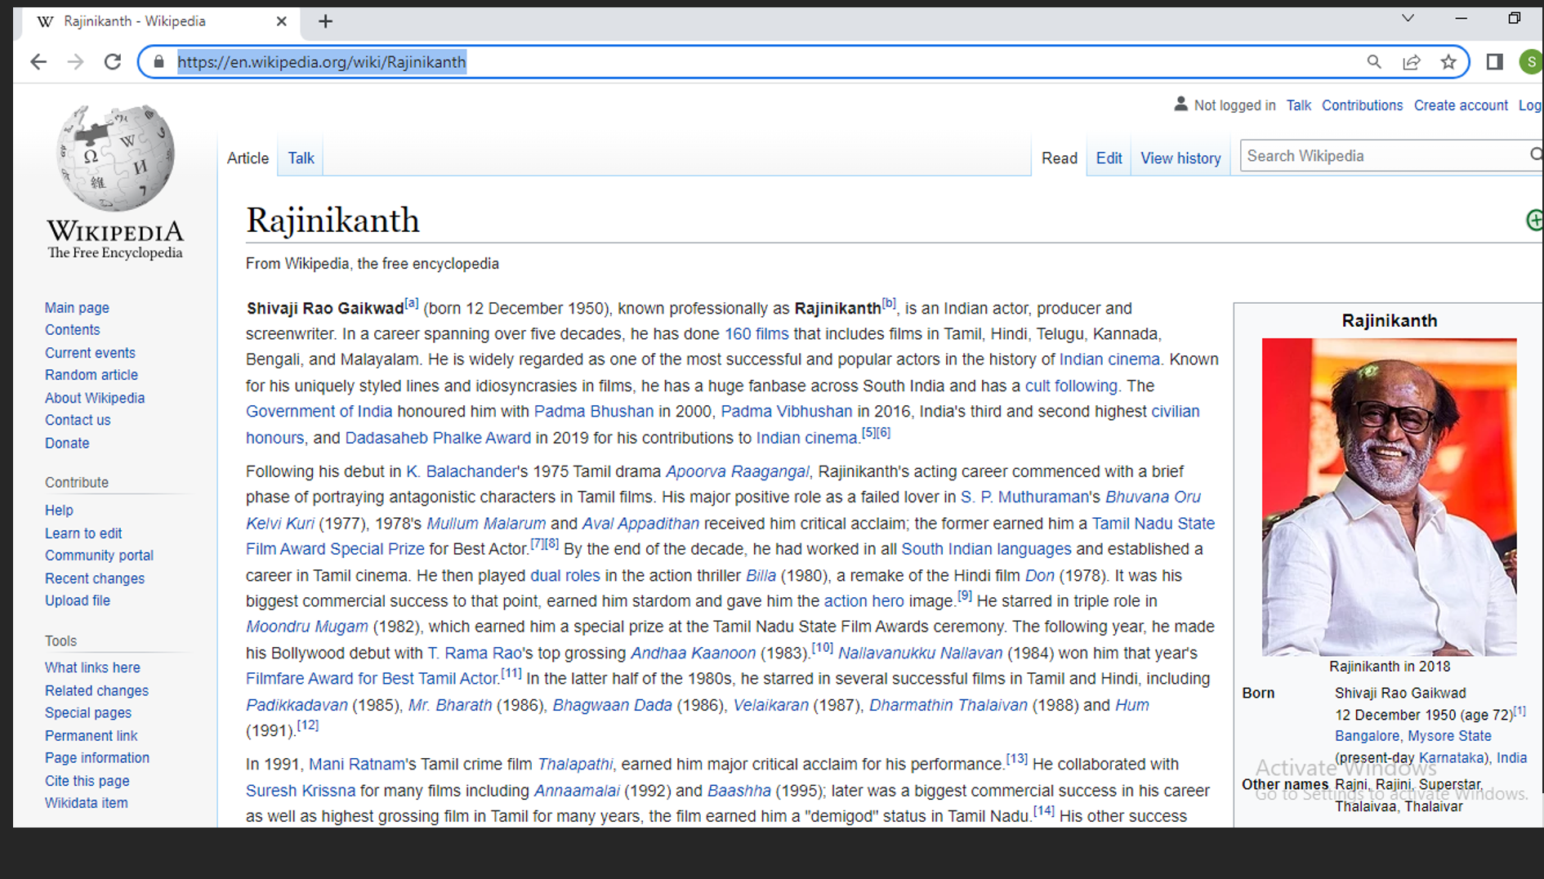
How to short url :
Eg :

Slide 14
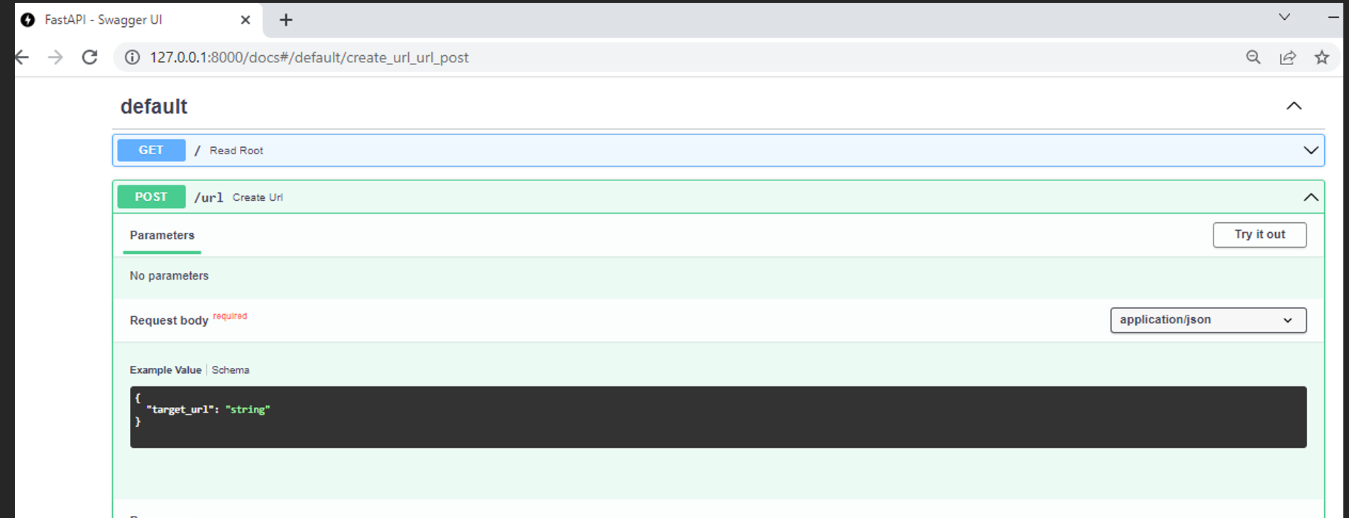

Slide 15
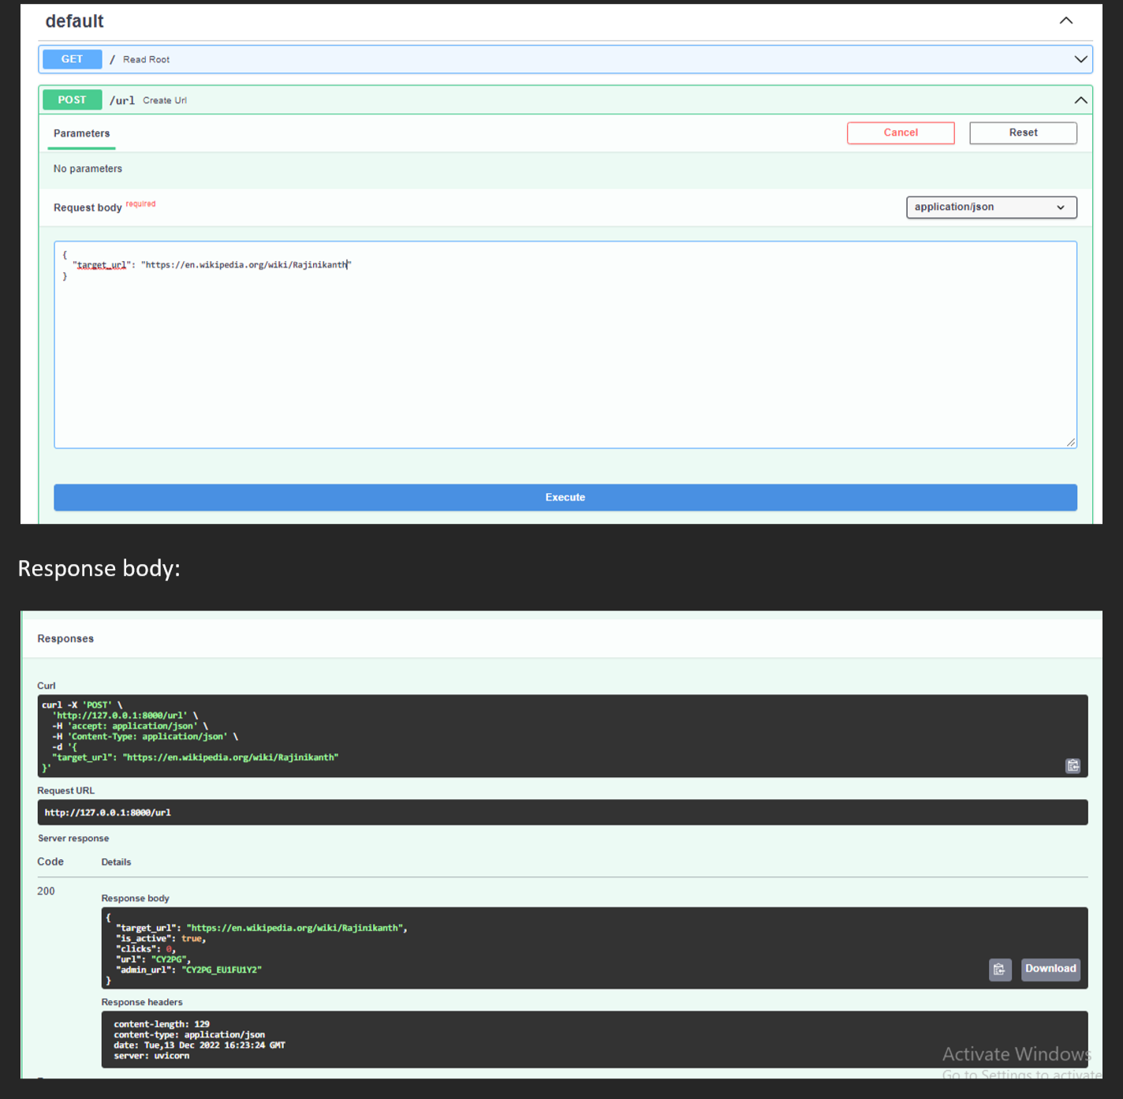

Slide 16
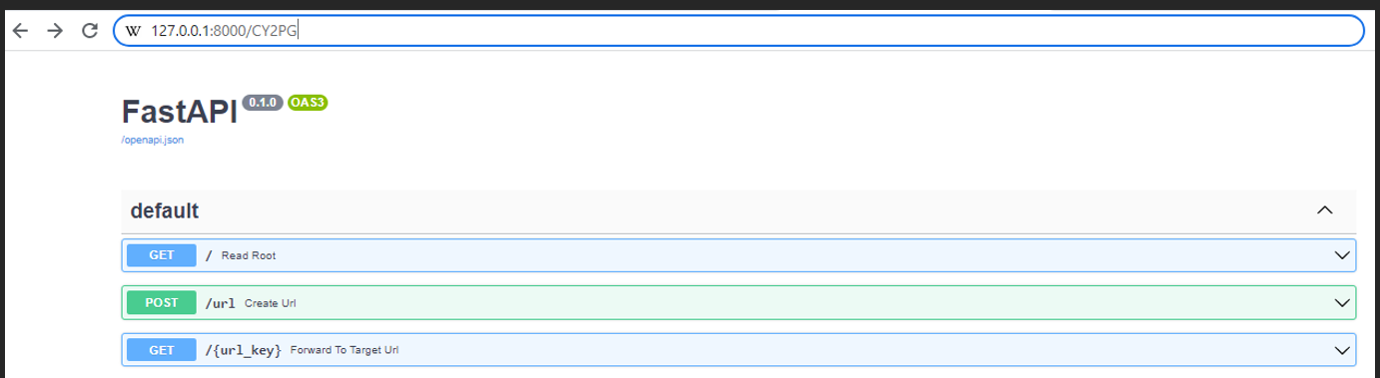
FORWARD TO THE URL

Slide 17
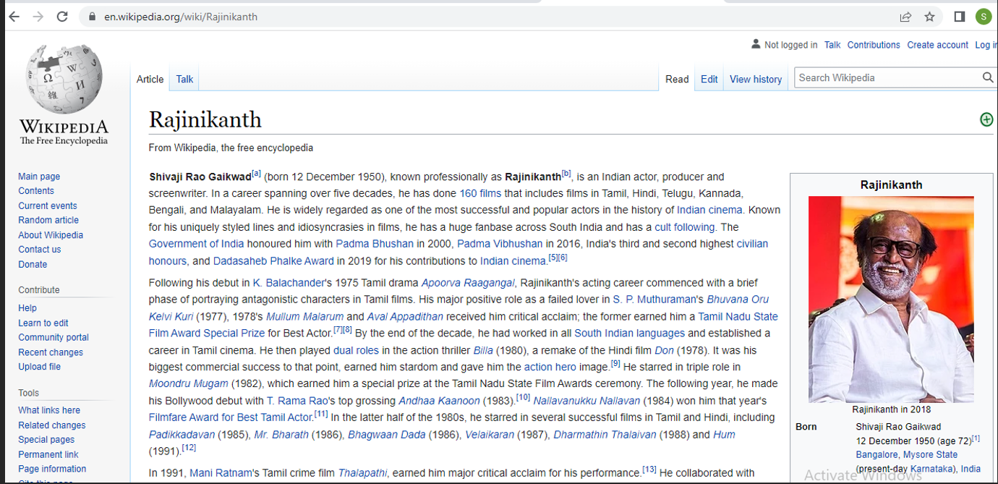
result
Once you’ve used the POST endpoint of our app,verify that the request created the database entries accordingly:

Slide 18
1>>>from shortener_app.database import sessionLocal
2Loading setting for:Development
3>>>db=SessionLocal
4
5>>>from shortener_app.models import URL
6>>>db.query(URL).all()
[<shortener_app.models.URL object at 0*104c65cc0>,…..]
With db.query(URL).all()you’re querying all entries of your URL table. In return,you get a list of all database entires that you created with the POST requests that you sent over to your API.

Slide 19
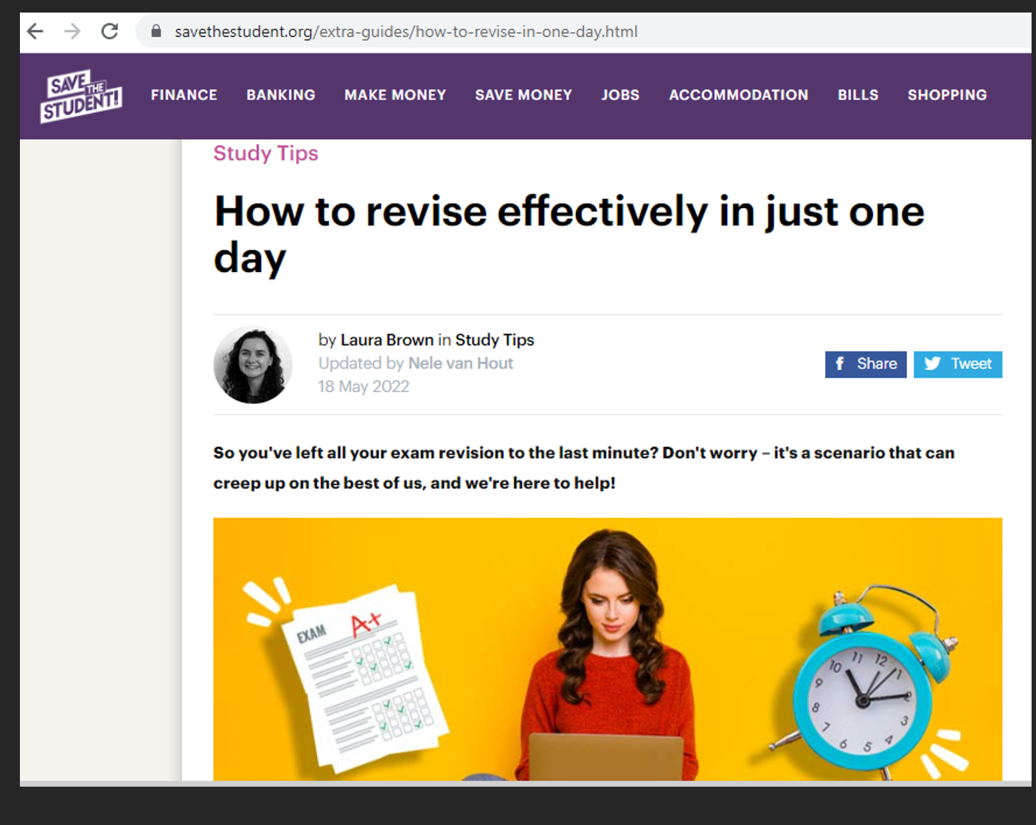
SOME EXAMPLE:

Slide 20
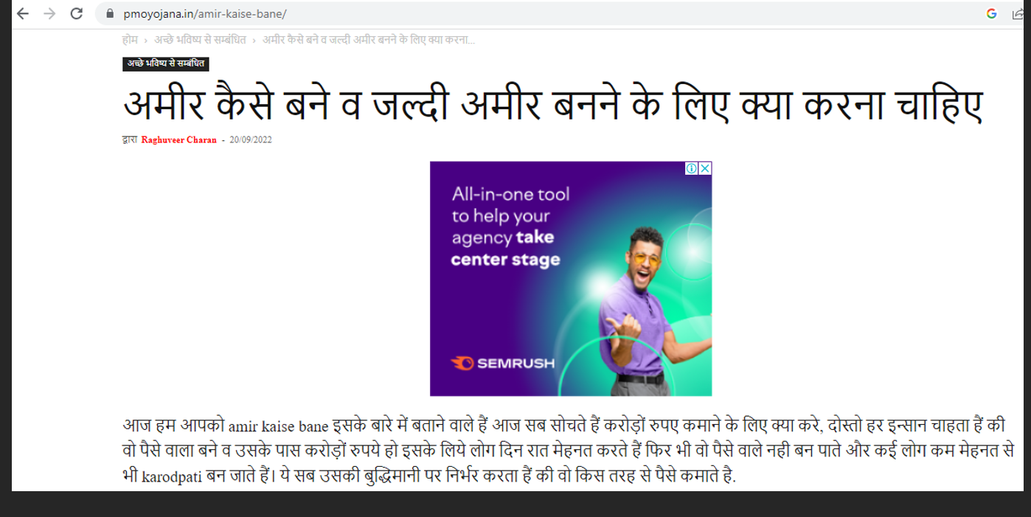

Slide 21
FUTURE SCOPE
URL shortcodes mask the original web link and shorten it– This masking can help in a great way when we are trying to promote our brand in social media or sending in short messages. It helps in simplifying the content of a post by giving a shorter link that is easier to present and include in the content without creating clutter. (inner image space)Sharing becomes much easier and simpler with a shorter URL that helps to save a lot of space while presenting info. It improves the presentation of information by manifolds as it removes the addition of long URLS to redirect the audience.
URL shortening allows traffic monitoring– Using URL shortners allows a business to keep a track of how many visitors clicked on the link and how many were actually converted. Some URL shorteners allows to track the engagement and also to check the scrolls. This kind of information is of great value for a business to understand the effectiveness the content and marketing strategies.

Slide 22
Thank you

